Slide 1
Servlet & JSON usage
Dr. Jeff Hill

Slide 2
Servlets & serialized data
Last class, we covered:
Containers
Servlets
HTML (Basic)
XML & JSON
Now, we’ll put them into basic practice
There is a simple assignment associated with these techniques (simple)
You will construct your team project using these techniques (intermediate)

Slide 3
Its all about the data
Simple websites are generally 1 of 3 main types:
Data presentation (web page)
Data collection (web form)
Data service provider (web service)
Most contemporary websites are all 3
But when you break down the functions on individual pages
They are 1 or 2 of the above

Slide 4
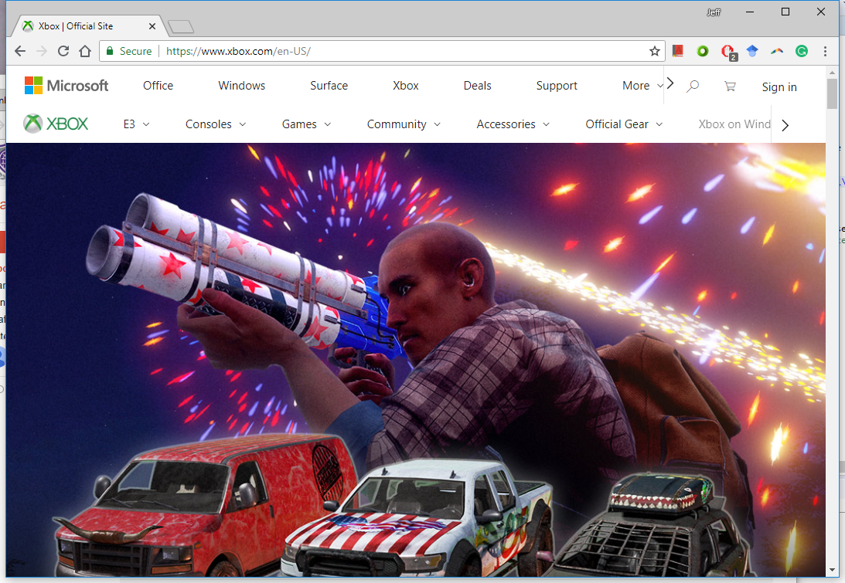
Data presentation

Slide 5
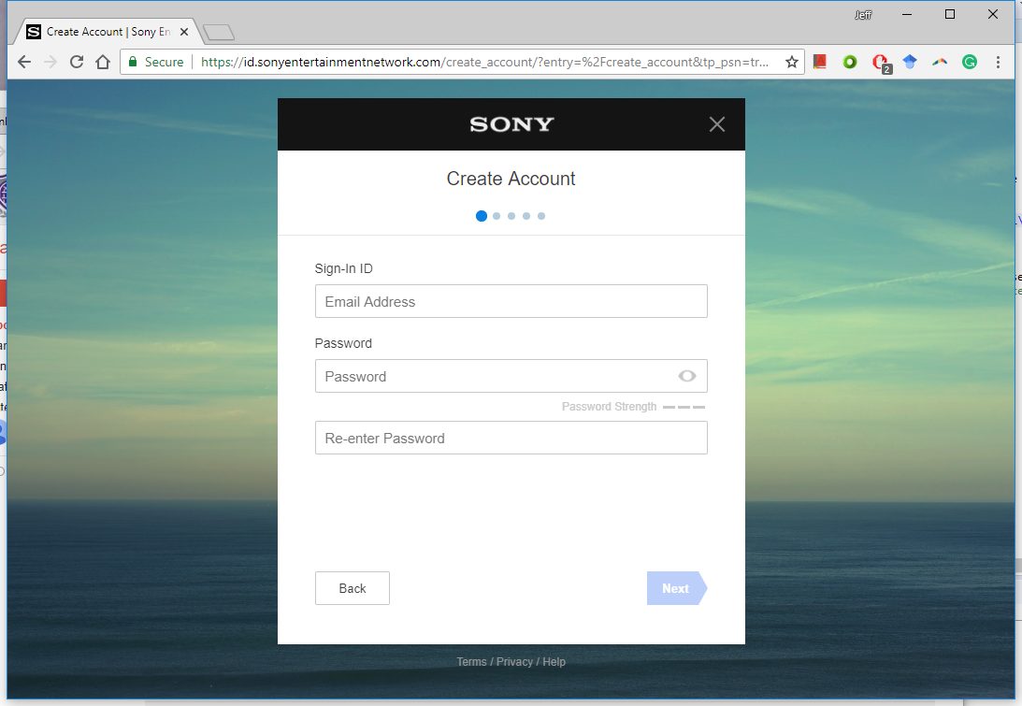
Data collection

Slide 6
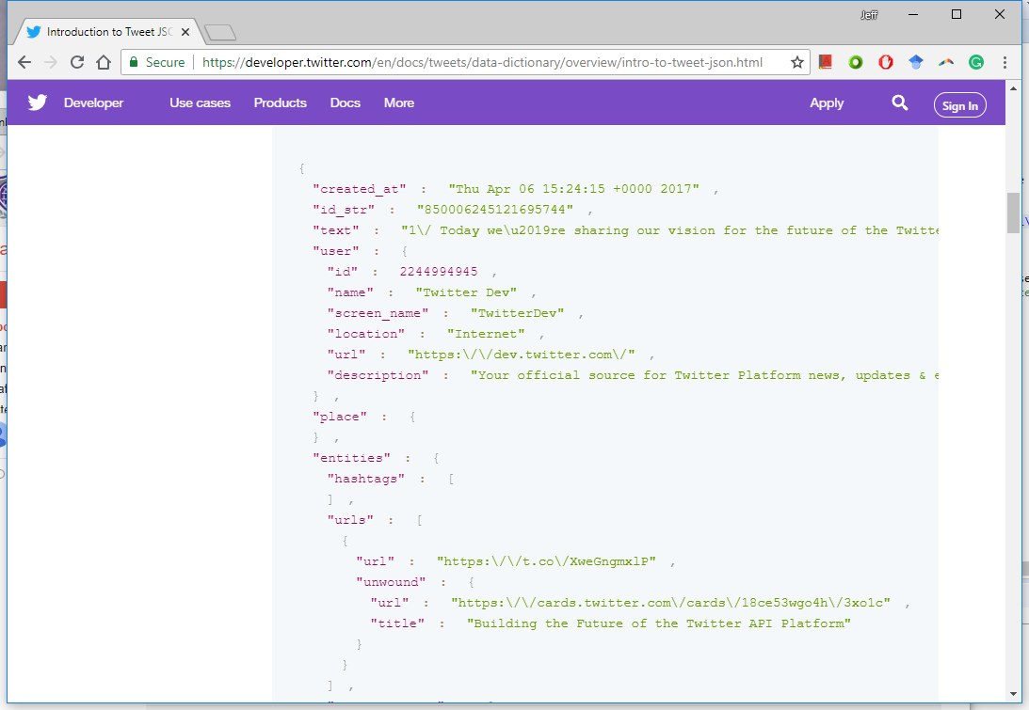
Data service provider

Slide 7
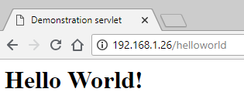
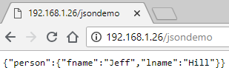
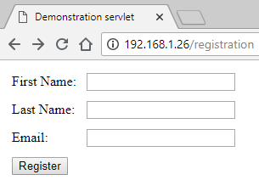
Examples
We did 2 of these with last class’s simple examples:
Data presentation
Data service provision
Now we’ll discuss the 3rd type
Data collection

Slide 8
Data collection form
package class22;
import java.io.IOException;
import java.io.PrintWriter;
import javax.servlet.ServletException;
import javax.servlet.http.HttpServlet;
import javax.servlet.http.HttpServletRequest;
import javax.servlet.http.HttpServletResponse;
public class UserRegistration extends HttpServlet {
private static final long serialVersionUID = 4L;
@Override
public void doGet(HttpServletRequest request, HttpServletResponse response) throws ServletException, IOException {
response.setContentType("text/html");
PrintWriter out = response.getWriter();
out.println("<html><head><title>Demonstration servlet</title></head><body>");
out.println("<form action=\"/registration\" method=\"post\">");
out.println("<table border=\"0\" cellpadding=\"5\">");
out.println("<tr><td>First Name:</td><td><input type=\"textbox\" name=\"fname\"></td></tr>");
out.println("<tr><td>Last Name:</td><td><input type=\"textbox\" name=\"lname\"></td></tr>");
out.println("<tr><td>Email:</td><td><input type=\"textbox\" name=\"email\"></td></tr>");
out.println("<tr><td colspan=\"2\"><input type=\"submit\" value=\"Register\"></td></tr>");
out.println("</table>");
out.println("</form>");
out.println("</body></html>");
} // end doGet
@Override
public void doPost(HttpServletRequest request, HttpServletResponse response) throws ServletException, IOException {
response.setContentType("text/html");
PrintWriter out = response.getWriter();
out.println("<html><body><title>Registration Successful!</title>");
out.println("<h1>Registration Successful!</h1>");
out.println("</body></html>");
} // end doPost
} // end UserRegistration
The servlet is created in 2 pieces
The .doGet() method is used to define the HTML form
The .doPost() method is used to define the form’s handler

Slide 9
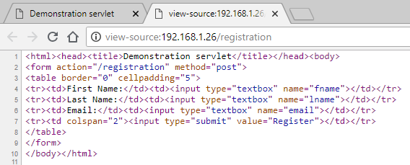
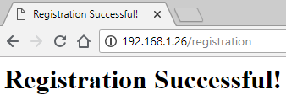
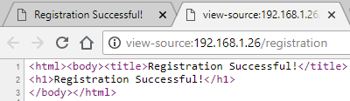
Data collection form
The prior Java code results in the following HTML
Right-click select “View page source”
Depends on your favored browser

Slide 10
Data collection form
Note: we are assuming the user always submits good data!
Get the submitted data values
Create the parameterized SQL statement
Attach data values as parameters
Submit SQL for processing
Let the user know it was successful
Data collection doesn’t just get tossed away…
Generally saved to a database
So the simple .doPost() method needs to evolve
@Override
public void doPost(HttpServletRequest request, HttpServletResponse response) throws ServletException, IOException {
try {
String fname = request.getParameter("fname");
String lname = request.getParameter("lname");
String email = request.getParameter("email");
OracleWrapper.prepareStatement("INSERT INTO USERS (fname, lname, email) VALUES (?,?,?)", fname, lname, email);
OracleWrapper.updateDB();
} catch (SQLException e) {
System.out.println(e.getMessage());
} // end catch
response.setContentType("text/html");
PrintWriter out = response.getWriter();
out.println("<html><body><title>Registration Successful!</title>");
out.println("<h1>Registration Successful!</h1>");
out.println("</body></html>");
} // end doPost
Don’t forget to add the database uca-database-wrapper.jar & ojdbc7.jar files to the classpath if necessary and add these imports to the class:
import uca.mis3339.OracleWrapper;
import java.sql.SQLException;

Slide 11
Data collection form
public class UserLogin extends HttpServlet {
private static final long serialVersionUID = 4L;
@Override
public void doGet(HttpServletRequest request, HttpServletResponse response) throws ServletException, IOException {
response.setContentType("text/html");
PrintWriter out = response.getWriter();
out.println("<html><head><title>User Login</title></head><body>");
out.println("<form action=\"/login\" method=\"post\">");
out.println("<table border=\"0\" cellpadding=\"5\">");
out.println("<tr><td>Email:</td><td><input type=\"textbox\" name=\"email\"></td></tr>");
out.println("<tr><td colspan=\"2\"><input type=\"submit\" value=\"Login\"></td></tr>");
out.println("</table>");
out.println("</form>");
out.println("</body></html>");
} // end doGet
@Override
public void doPost(HttpServletRequest request, HttpServletResponse response) throws ServletException, IOException {
boolean login = false;
try {
String email = request.getParameter("email");
OracleWrapper.prepareStatement("SELECT fname, lname, email FROM USERS WHERE email = ?", email);
ResultSet rs = OracleWrapper.queryDB();
if (rs.next()) { // if no records were returned, then there was no match in the database
login = true;
} // end if
} catch (SQLException e) {
System.out.println(e.getMessage());
e.printStackTrace();
} // end catch
response.setContentType("text/html");
PrintWriter out = response.getWriter();
if (login) {
out.println("<html><body><title>Login Successful!</title>");
out.println("<h1>Login Successful!</h1>");
} else {
out.println("<html><body><title>Login Unsuccessful!</title>");
out.println("<h1>Login Unsuccessful!</h1>");
} // end else
out.println("</body></html>");
} // end doPost
} // end UserRegistration
Prior example was for data retention
If we want to collect data for database comparison (e.g. login) we have to change things up a bit

Slide 12
Data service provision
Now that we have a table with multiple data records
We can convert those results to JSON by 2 methods
Manually parsing each database column value and concatenating along with string escape characters
Very error prone!
Use a Java class to help us generate the JSON
We only have to make the string concatenation with escape sequences one time
Less likely to make a mistake

Slide 13
JSON (basic)
public class UserReportJSONBasic extends HttpServlet {
private static final long serialVersionUID = 5L;
@Override
public void doGet(HttpServletRequest request, HttpServletResponse response) throws ServletException, IOException {
response.setContentType("application/json");
PrintWriter out = response.getWriter();
try {
OracleWrapper.prepareStatement("SELECT fname, lname, email FROM USERS");
ResultSet rs = OracleWrapper.queryDB();
out.println("{\"accounts\":[");
boolean hasNext = rs.next(); // needed to add comma between records
while (hasNext) {
out.println("{\"fname\":\"" + rs.getString(1) + "\",");
out.println("\"lname\":\"" + rs.getString(2) + "\",");
out.println("\"email\":\"" + rs.getString(3) + "\"}");
hasNext = rs.next(); // needed to add comma between records
if (hasNext) { // needed to add comma between records
out.println(","); // needed to add comma between records
} // end if
} // end if
out.println("]}");
} catch (SQLException e) {
System.out.println(e.getMessage());
e.printStackTrace();
} // end catch
} // end doGet
@Override
public void doPost(HttpServletRequest request, HttpServletResponse response) throws ServletException, IOException {
// do nothing
} // end doPost
} // end UserReportJSONBasic

Slide 14
JSON (advanced)
package class22;
public class Account {
private final String fName;
private final String lName;
private final String email;
public Account(String incfName, String inclName, String incEmail) {
this.fName = incfName;
this.lName = inclName;
this.email = incEmail;
} // end ctor
@Override
public String toString() {
return "{\"fname\":\"" + this.fName + "\", \"lname\":\""
+ this.lName + "\", \"email\":\"" + this.email + "\"}";
} // end toString
} // end Account
public class UserReportJSONAdvanced extends HttpServlet {
private static final long serialVersionUID = 6L;
@Override
public void doGet(HttpServletRequest request, HttpServletResponse response) throws ServletException, IOException {
response.setContentType("application/json");
PrintWriter out = response.getWriter();
try {
List<Account> allAccounts = new ArrayList();
OracleWrapper.prepareStatement("SELECT fname, lname, email FROM USERS");
ResultSet rs = OracleWrapper.queryDB();
while (rs.next()) {
allAccounts.add(new Account(rs.getString(1), rs.getString(2), rs.getString(3)));
} // end while
out.println("{\"accounts\":[");
for (Account eachOne: allAccounts) {
out.println(eachOne.toString());
if (allAccounts.indexOf(eachOne) != allAccounts.size()-1) { // test if this is the last record
out.print(","); // add a comma if not the last record
} // end if
} // end for
out.println("]}");
} catch (SQLException e) {
System.out.println(e.getMessage());
e.printStackTrace();
} // end catch
} // end doGet
@Override
public void doPost(HttpServletRequest request, HttpServletResponse response) throws ServletException, IOException {
// do nothing
} // end doPost
} // end UserReportJSONAdvanced

Slide 15
HTML (advanced)
Add to Account class
public String toHTML() {
return "<tr><td>First name: </td><td>" + this.fName + "</td></tr>"
+ "<tr><td>Last name: </td><td>" + this.lName + "</td></tr>"
+ "<tr><td>Email: </td><td>" + this.email + "</td></tr>";
} // end toHTML
public class UserReportHTMLAdvanced extends HttpServlet {
private static final long serialVersionUID = 7L;
@Override
public void doGet(HttpServletRequest request, HttpServletResponse response) throws ServletException, IOException {
response.setContentType("text/html");
PrintWriter out = response.getWriter();
try {
List<Account> allAccounts = new ArrayList();
OracleWrapper.prepareStatement("SELECT fname, lname, email FROM USERS");
ResultSet rs = OracleWrapper.queryDB();
while (rs.next()) {
allAccounts.add(new Account(rs.getString(1), rs.getString(2), rs.getString(3)));
} // end while
out.println("<html><head><title>User Report</title></head><body>");
out.println("<table border=\"0\" cellpadding=\"5\">");
for (Account eachOne: allAccounts) {
out.println(eachOne.toHTML());
} // end for
out.println("</table></body></html>");
} catch (SQLException e) {
System.out.println(e.getMessage());
e.printStackTrace();
} // end catch
} // end doGet
@Override
public void doPost(HttpServletRequest request, HttpServletResponse response) throws ServletException, IOException {
// do nothing
} // end doPost
} // end UserReportHTMLAdvanced

Slide 16
Questions?

